Slide 1

DTSA 5510, Unsupervised machine learning
Final project

Slide 2
contents
Problem Statement
Gather Data
EDA
Modeling
Discussion and Conclusions

Slide 3
Problem statement
An individual's profession and career can be fundamental to not only their economic prosperity, but also their mental and emotional well-being. There are a lot of considerations when it comes to finding a job, but among them are the components that make up the day-to-day activities of work. These can be described as several different features:
Knowledge
Skills
Abilities
Work activities
But what happens when someone wants to change their role, but also wants to properly transition their skillset to a new role? This can happen for a variety of reasons. Sometimes, this can be a simple change of desire, in which someone might use a career coach, mentor, etc.
However, there are other reasons someone may switch job titles, which will be discussed below. When these reasons are out of someone's hands, they may want to find jobs most similar to theirs. How can this be done algorithmically?

Slide 4

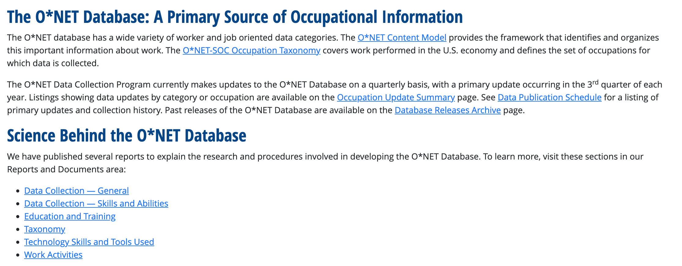
Gather data
Data available online, database in Excel, TXT, and other formats
Downloaded zipped file of Excels, uploaded to Google Drive for easy access

Slide 5
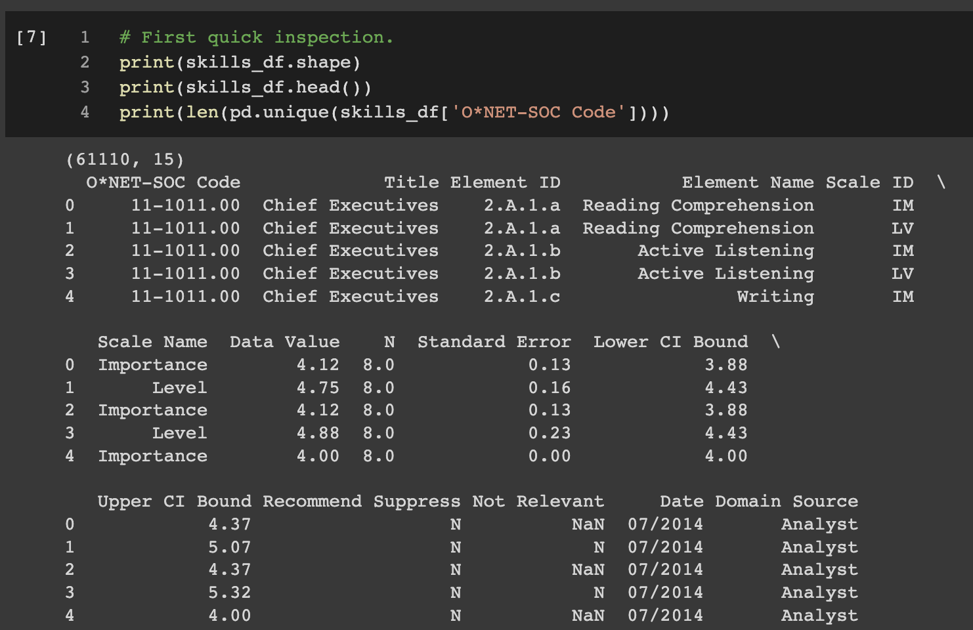
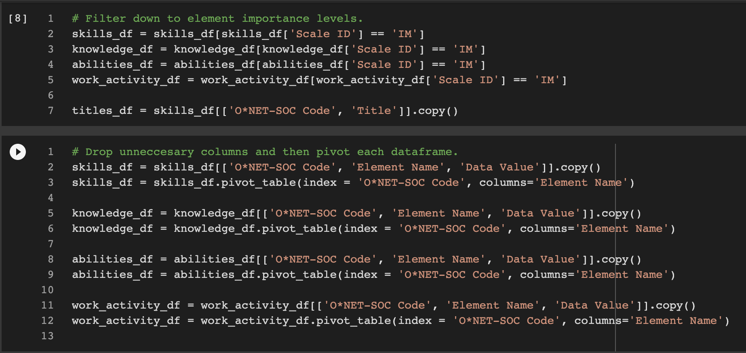
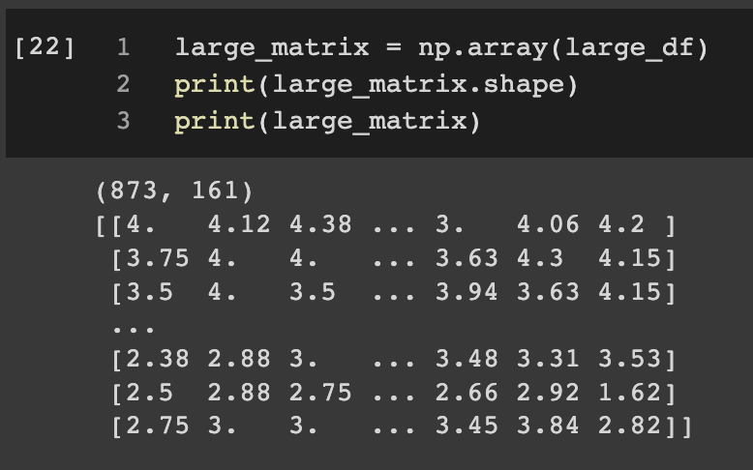
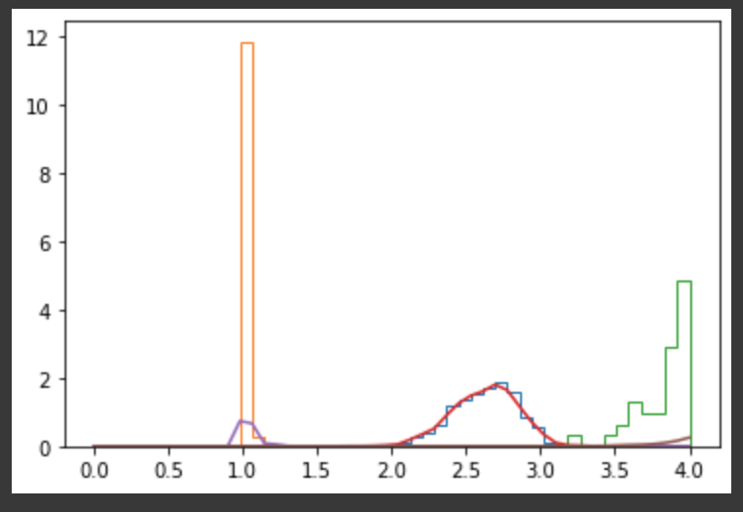
eda
Winnow down to “Importance” instead of “Level”
Pivot each dataframe, features (columns) x observations (rows)
Combine dataframes to amass all features
Convert to numpy array/matrix

Slide 6
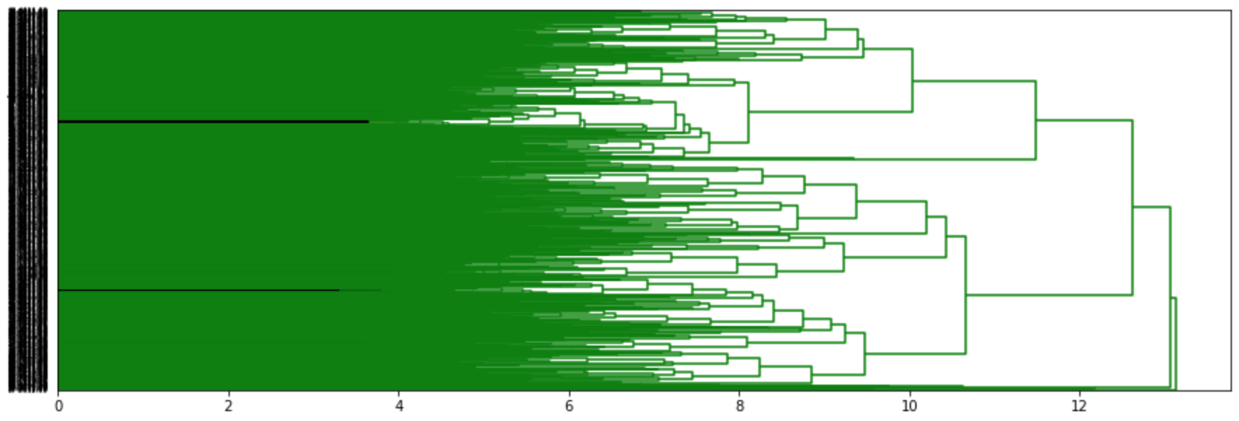
modeling
Scipy’s hierarchical package, hierarchical clustering
Dendrogram, but most use from distance measures and distance matrix
Hyperparameter tuning

Slide 7
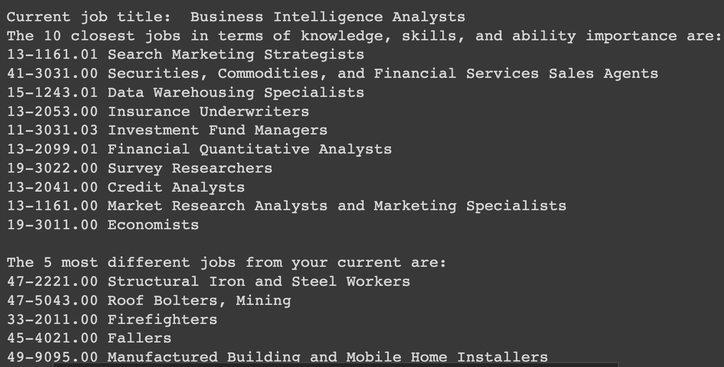
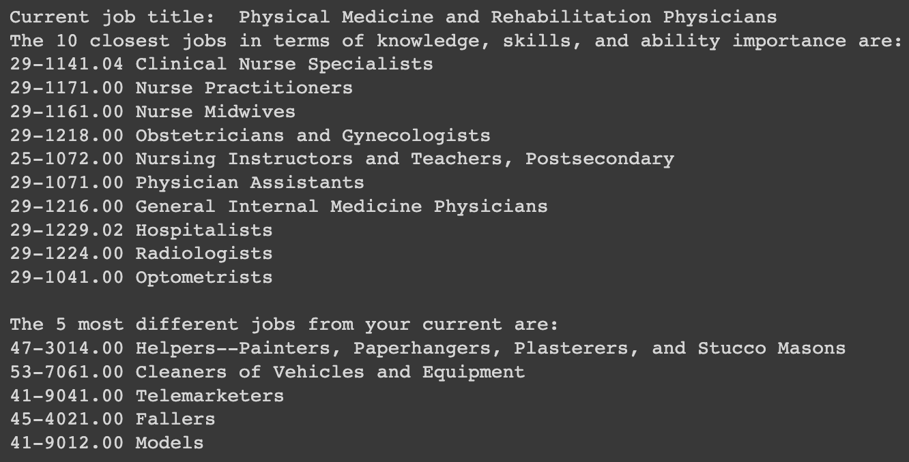
Discussion and conclusions
Continued hyperparameter tuning based on iterative feedback from users of an app.
Closeness calculations based off of particular element types rather than all elements (say, Knowledge and Skills, but not Work Activities).
Application feature optimization, such as level-setting for individual features.

